Slide 1

Determination of Resin Components for continuous Digital Light Processing (cDLP) Additive Manufacture of Resorbable Tissue Engineering Scaffolds
David Dean¹, Eric Mott¹, Xinyi Luo², Mallory Busso², Martha O. Wang³, Charlotte Vorwald³, Al Siblani⁴, and John P. Fisher³
Department of ¹Plastic Surgery
The Ohio State University, Columbus, Ohio USA
Department of ²Neurological Surgery
Case Western Reserve University, Cleveland, Ohio USA
³EnvisionTEC, Inc., Dearborn, Michigan USA
⁴Fischell Department of Bioengineering, University of Maryland
College Park, Maryland USA
October 4, 2013
Notes:
Thank you for the introduction. I would like to thank the conference organizers for selecting this paper for presentation at this 5th VRAP meeting. I would like to begin my talk by thanking the conference organizers and reviewers of our manuscript for inviting me and giving me the honor of presenting at this conference. I was at the 2009 VRAP meeting. I thoroughly enjoyed that meeting and learned quite a bit. I am looking forward to VRAP 2011.

Slide 2
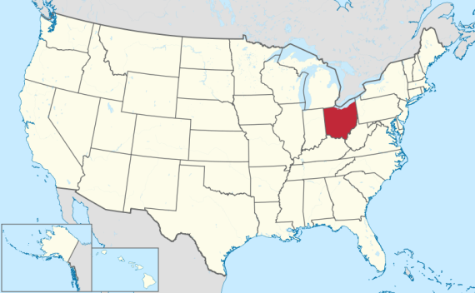

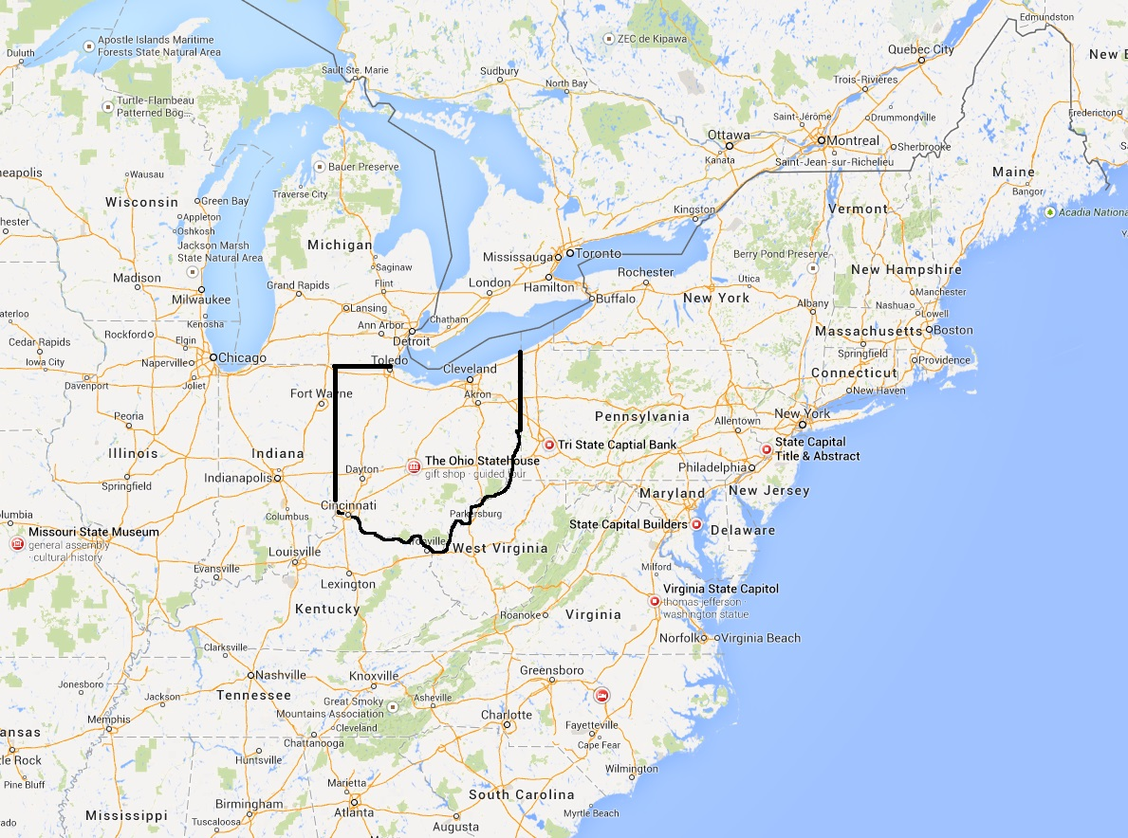



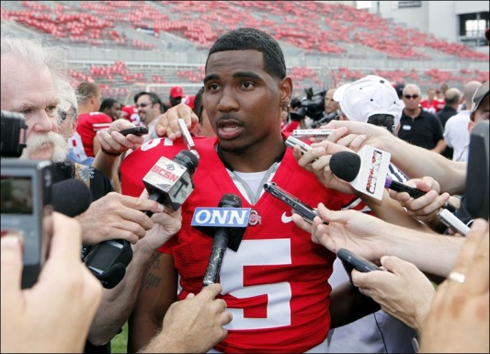

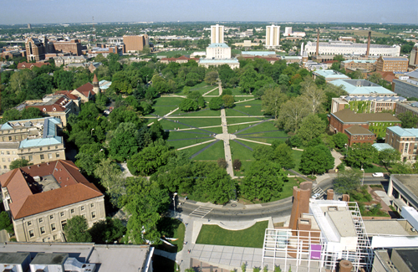
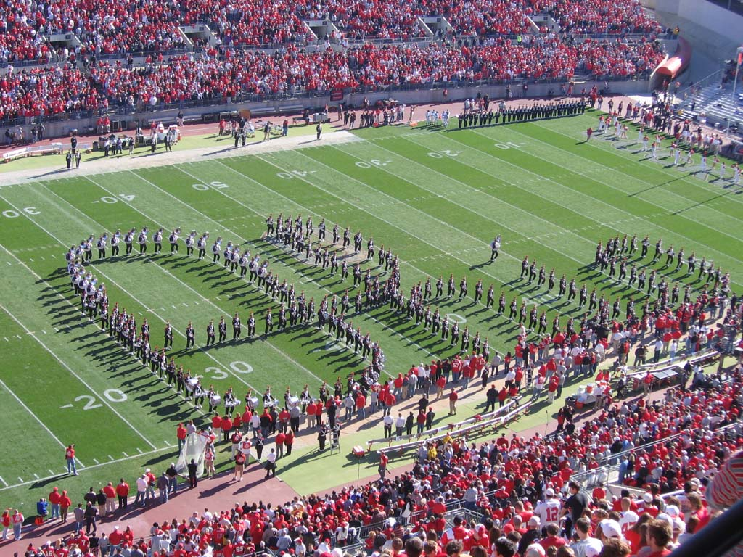

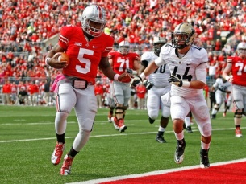

Columbus, OH
Ohio State University
October 4, 2013

Slide 3
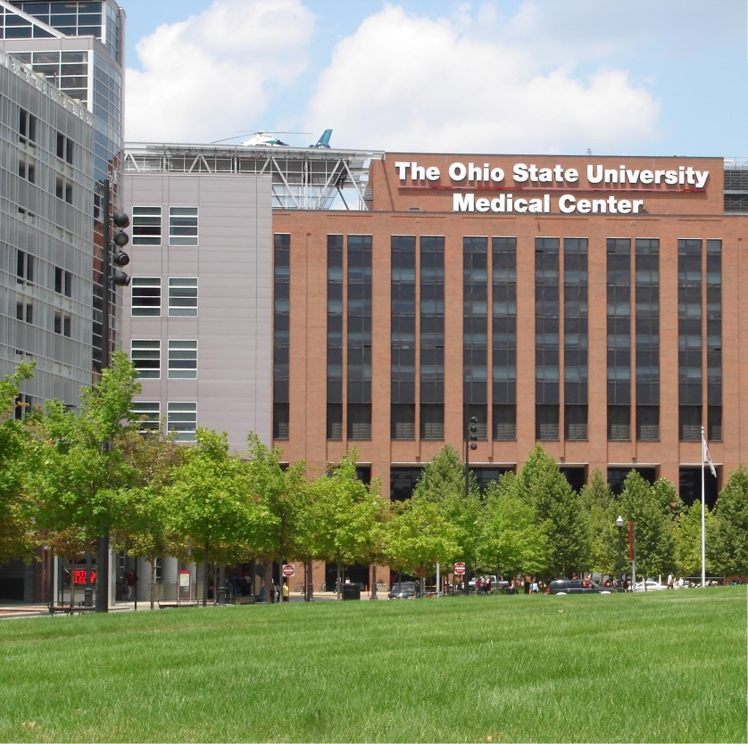



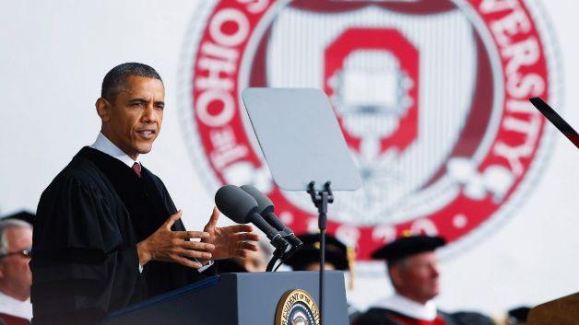
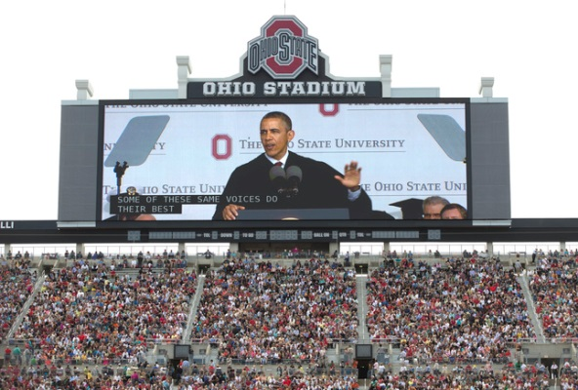

The Ohio State University
Columbus, OH
Campus 7 km²
64,429 Students
56,867Undergraduate
13,951 Postgraduate
6,254 Academic Staff
Div I-AAA: 19 mens,
20 womens varsity sports teams
475,000 living alumni
Cleveland, Ohio
October 4, 2013

Slide 4

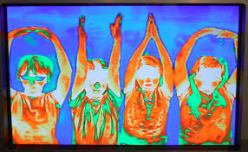
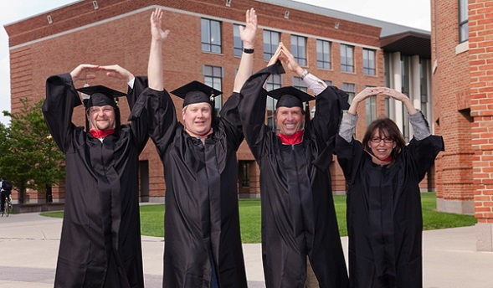

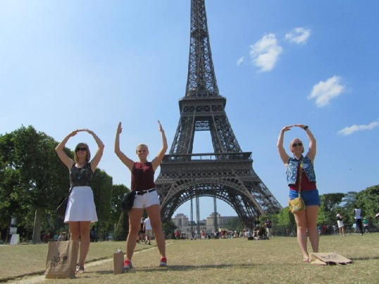


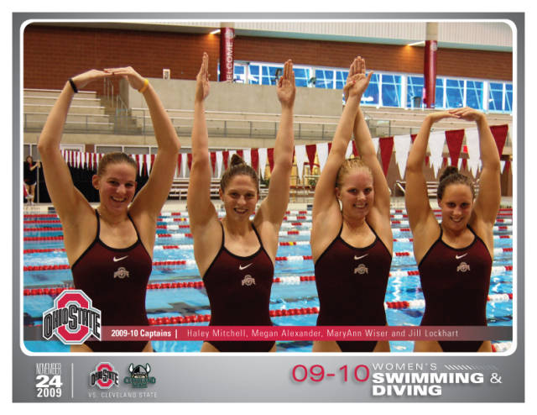



O-H-I-O

Slide 5
Disclosure
I have a Research Collaboration Agreement (RCA) with EnvisionTEC, Inc. (Dearborn, MI), a 3D printer manufacturer. I am the lead inventor of patents assigned to, and have received compensation from, and have an ownership stake in, Osteoplastics, LLC (Shaker Heights, OH).
October 4, 2013
Notes:
Talk overview

Slide 6
Overview
I Clinical Problem: Large Cranial Defects
II Cranial Implant Computer Aided Design (CAD)
III Light-based polymerization of PPF Scaffolds
IV Initiators, Dyes, Biologics, Crystals, and Solvents
V Discussion
October 4, 2013
Notes:
Talk overview

Slide 7
1.1 Neurocranial Deficit
Causes: trauma, surgery, cancer.
Gold standard treatment is autograft which must:
Protect brain from trauma
Protect brain from infection
Vascular supply is from dura:
Ability to revascularize declines with age
Likelihood of deficit increases with age
Failure to revascularize leads to:
Necrosis, resorption, and/or infection
Critical Size Skull Defect

Slide 8
1.2 Engrafting Large Defects
Autograft (calvarium, rib, ilium, fibula, metatarsal)
pain and morbidity at donor site.
graft may fail to vascularize.
Allograft (cadaver bone)
risk of disease transmission.
graft may fail to vascularize.

Slide 9
1.3 Additive Manufactured Skull Models for Manual Cranial Implant Preparation
Step one: render a 3D skull model from a 3D CT-scan on a 3D printer.
Step two: mold a skull plate by pushing clay against the skull model defect site.
Step three: is to re-cast this skull plate in PMMA implant or bend a titanium plate to fit its contours.

Slide 10
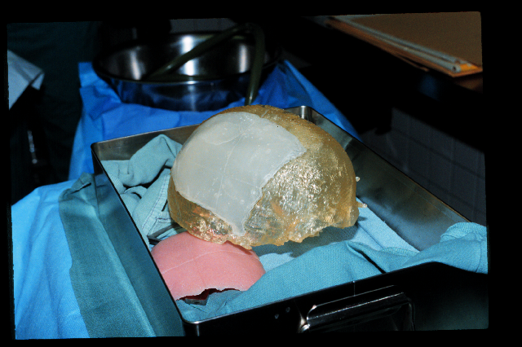
1.4 Pre- and Intra-operatively Malleable Alloplastic Graft Materials
Manually Determine Cosmesis
Titanium mesh plates
poor barrier to infection.
Hydroxyapatite Pastes
poor tensile strength.
PMMA
exothermic (gives off 180º F).
RP Skull Model: Skull model (beige), draft implant (red), final implant (white).

Slide 11
1.5 Bone Tissue Engineering
Resorbable polymers
Bone progenitor (stem) cells
Growth factors
A tissue engineered implant, that fit well, might facilitate:
host incorporation of the implant
graft incorporation and closure will protect from infection
remodeling of neobone to cortical bone will protect from trauma
A tissue engineering approach is already in the clinic for post-cranial applications (e.g., vertebral fusion), however these applications do not use stem cells.
Computer Aided Design (CAD) is frequently used to prepare inert, not tissue engineered, implants that fit the complex shapes of cranial defects very well.

Slide 12
Overview
I Clinical Problem: Large Cranial Defects
II Cranial Implant Computer Aided Design (CAD)
III Light-based polymerization of PPF Scaffolds
IV Initiators, Dyes, Biologics, Crystals, and Solvents
V Discussion
October 4, 2013
Notes:
Talk overview

Slide 13
2.1 Bottom-up CAD
Bottom-up design approach

Slide 14
2.2 Top Down Cranial CAD
Accurate cranial defect margin detection.
Interpolation of skull surface template into cranial defect.
Implant surface smoothing if right-left mirrored template.
Partitioning of implant surface from skull template.
Prosthetic edge and surface fit validation prior to fabrication.

Slide 15
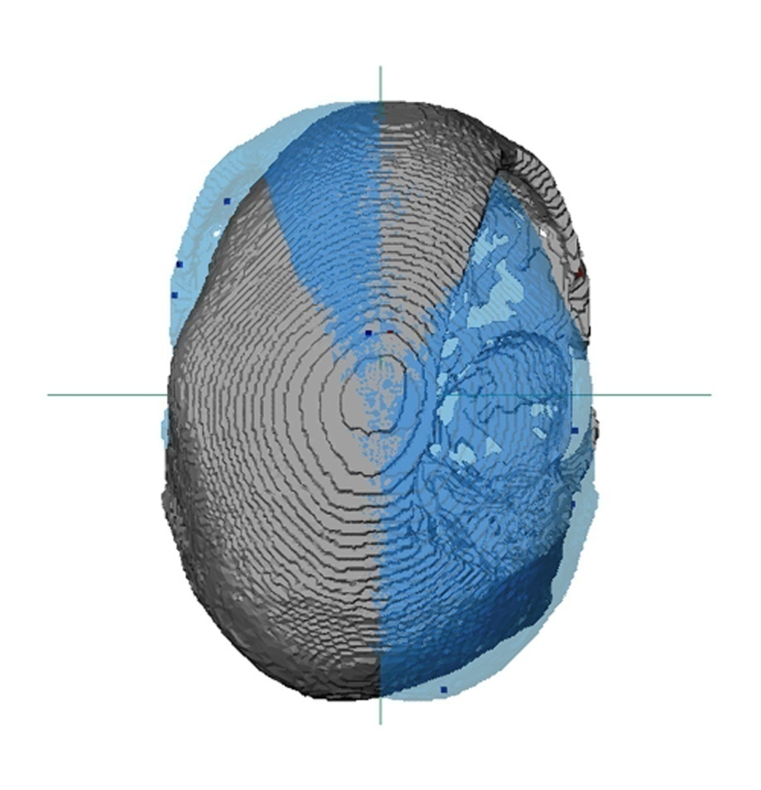
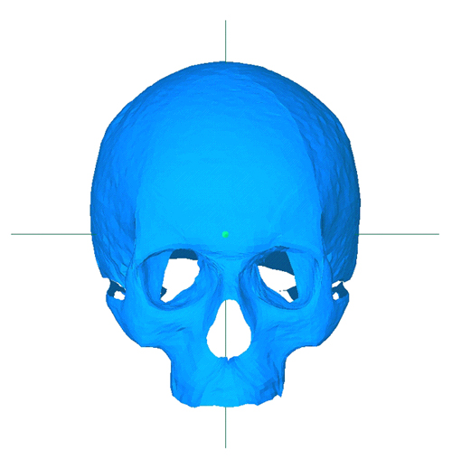
2.3 Unilateral and Bilateral Cranial Defect Skull Templates
Left-Right Mirrored Skull Template (Unilateral)
Average Skull Template (Bilateral)
Dean D, Min K-J, Bond A: Computer Aided Design of Pre-fabricated Cranial Plates. J. Craniofacial Surgery, 14:819-832, 2003.

Slide 16
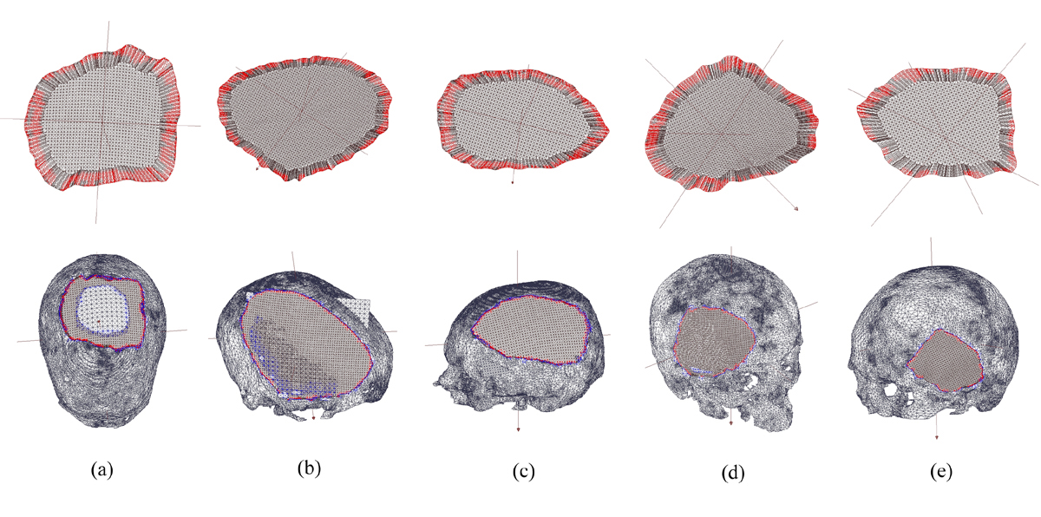
2.4 Cranial Implant Seating and Cosmesis
Min K-J and Dean D (2003) In R.E. Ellis and T.M. Peters (Eds.): MICCAI 2003, LNCS 2878, pp. 99-107, Berlin/Heidelberg: Springer-Verlag.

Slide 17
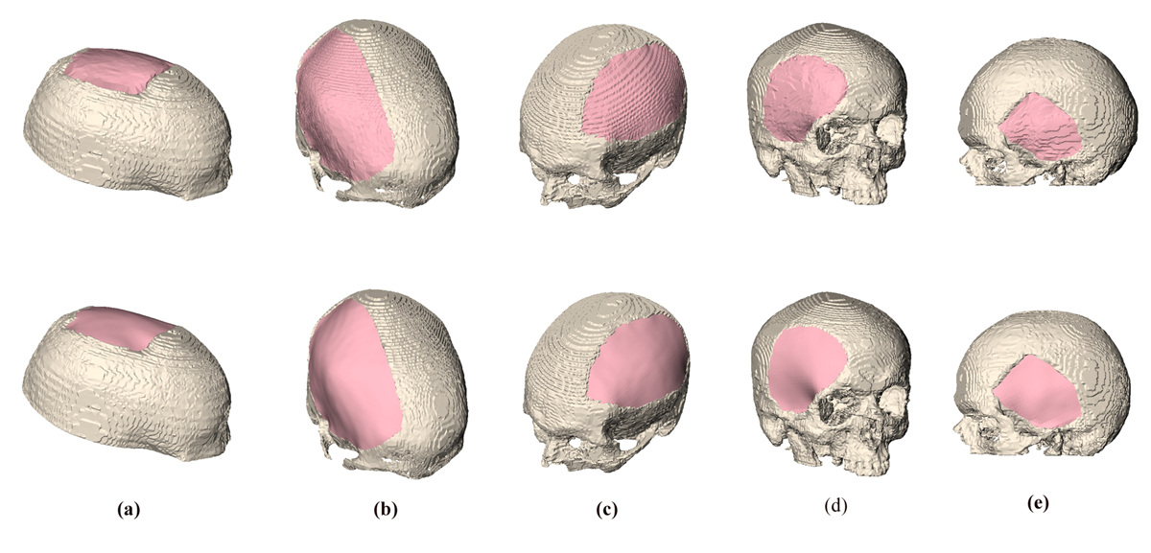
2.5 Five Smoothed Cranial Implants

Slide 18
Overview
I Clinical Problem: Large Cranial Defects
II Cranial Implant Computer Aided Design (CAD)
III Light-based polymerization of PPF Scaffolds
IV Initiators, Dyes, Biologics, Crystals, and Solvents
V Discussion
October 4, 2013
Notes:
Talk overview

Slide 19
3.1 Solid Freeform Fabrication (SFF) Technologies:
“This new paradigm requires scaffolds that balance temporary mechanical function with mass transport to aid biological delivery and tissue regeneration.” (Hollister SJ (2005) Porous Scaffold Design for Tissue Engineering. Nat Mater 4:518-524).

Slide 20
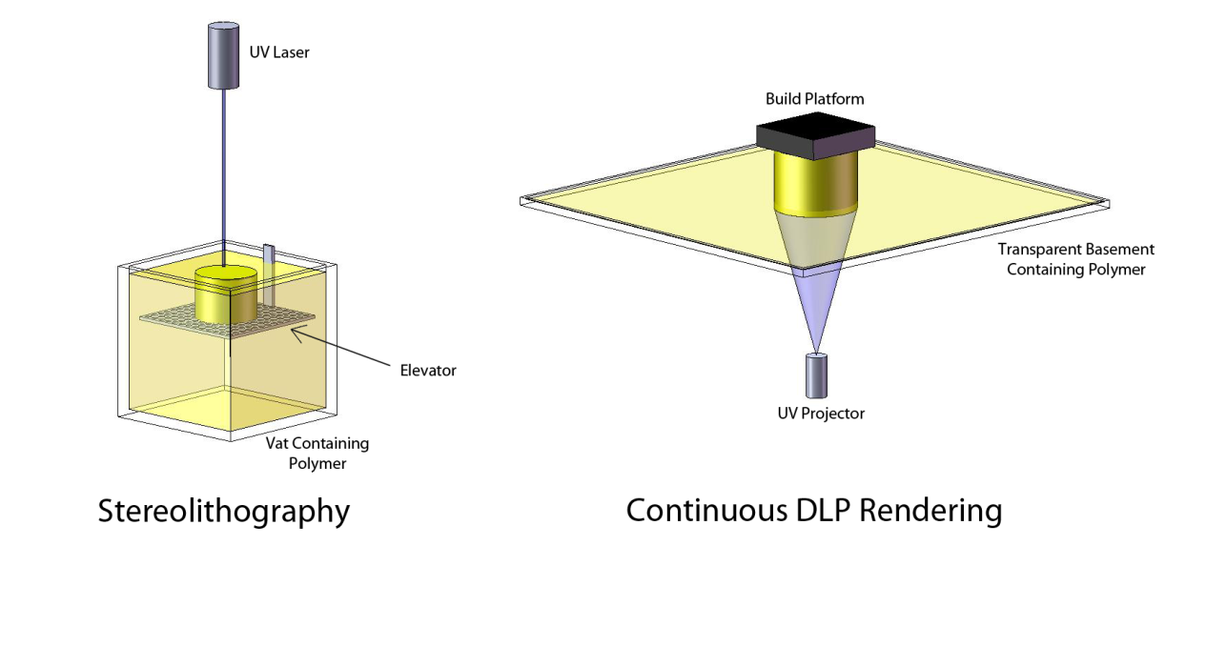
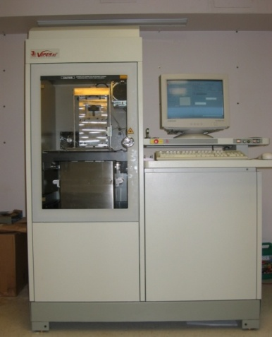
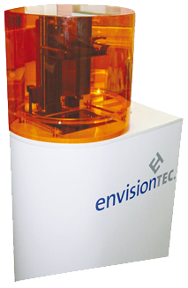
3.2 Additive Manufacturing
“[The] process of joining materials to make objects from 3D model data, usually layer upon layer… “ –ASTM F2792-10
Two additive manufacturing (AM) methods have very high accuracy
Both use ultraviolet light to photo-crosslink resorbable polymeric resins:
3D Systems Viper® HA SLA device
envisionTEC Perfactory® cDLP device
Stereolithography (SLA) and Continuous Digital Light Processing (cDLP) have both been used to polymerize poly(propylene fumarate) (PPF).

Slide 21
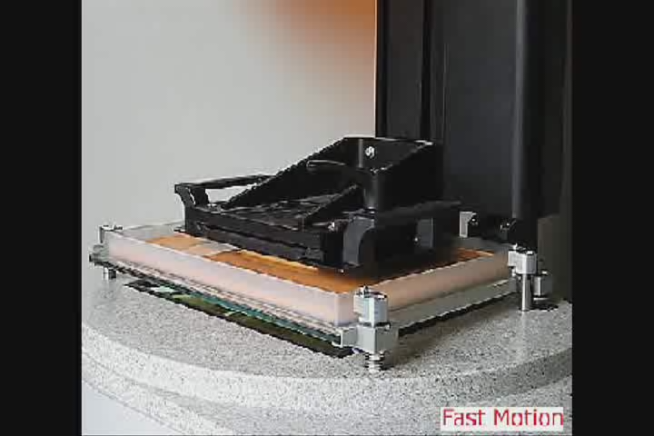
4.1 envisionTEC Perfactory
http://www.envisiontec.com/fileadmin/images/PerfMovieRC25.swf

Slide 22
3.3 Additive Manufacturing: Why Poly(propylene fumarate)?
Controllable degradation releases small amounts of fumaric acid:
Does not bulk degrade
Does not cause acidic spike
metabolized in Krebs cycle
Degradation control via:
Cross-linking density (stiffness)
molecular weight (strength)
Prior work with translucent molds.
Can be UV light polymerized in the presence of a photoinitiator.
Notes:
Osseointegration of PPF Cranial Implants
04/11/03
David Dean, Ph.D.
22

Slide 23
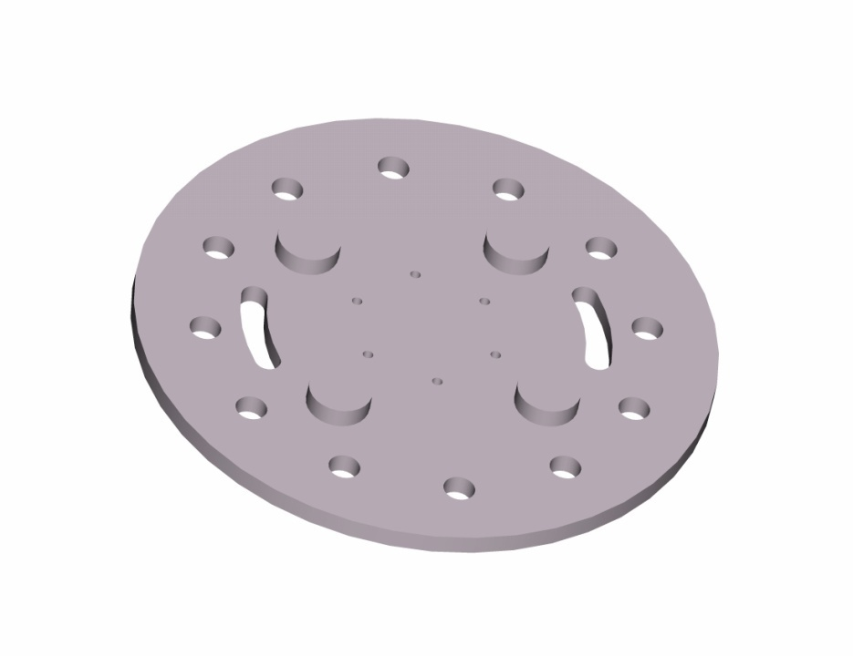
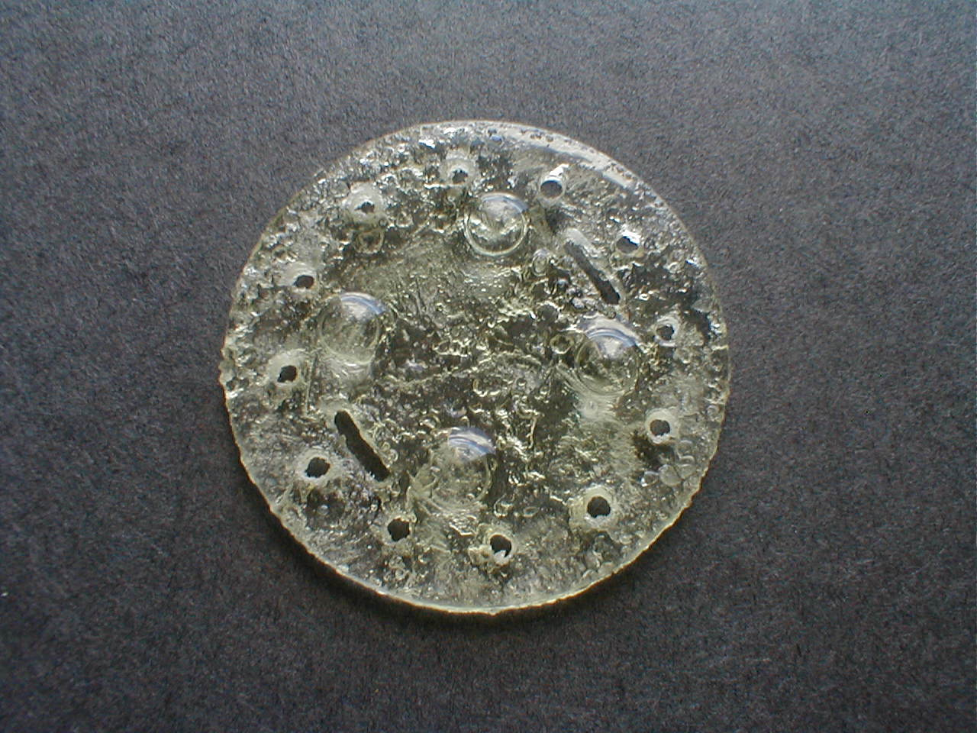
3.4 CWRU PPF SLA System
CAD implant design:
Designed in ProEngineerTM.
Dimensions are 50mm diameter x 4mm thick.
CAM implant output:
Complete dimensional accuracy.
Some support structures failed to build.
Journal of Biomedical Materials Research 64B: 65-59, 2003.

Slide 24
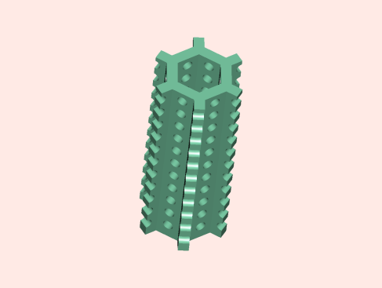
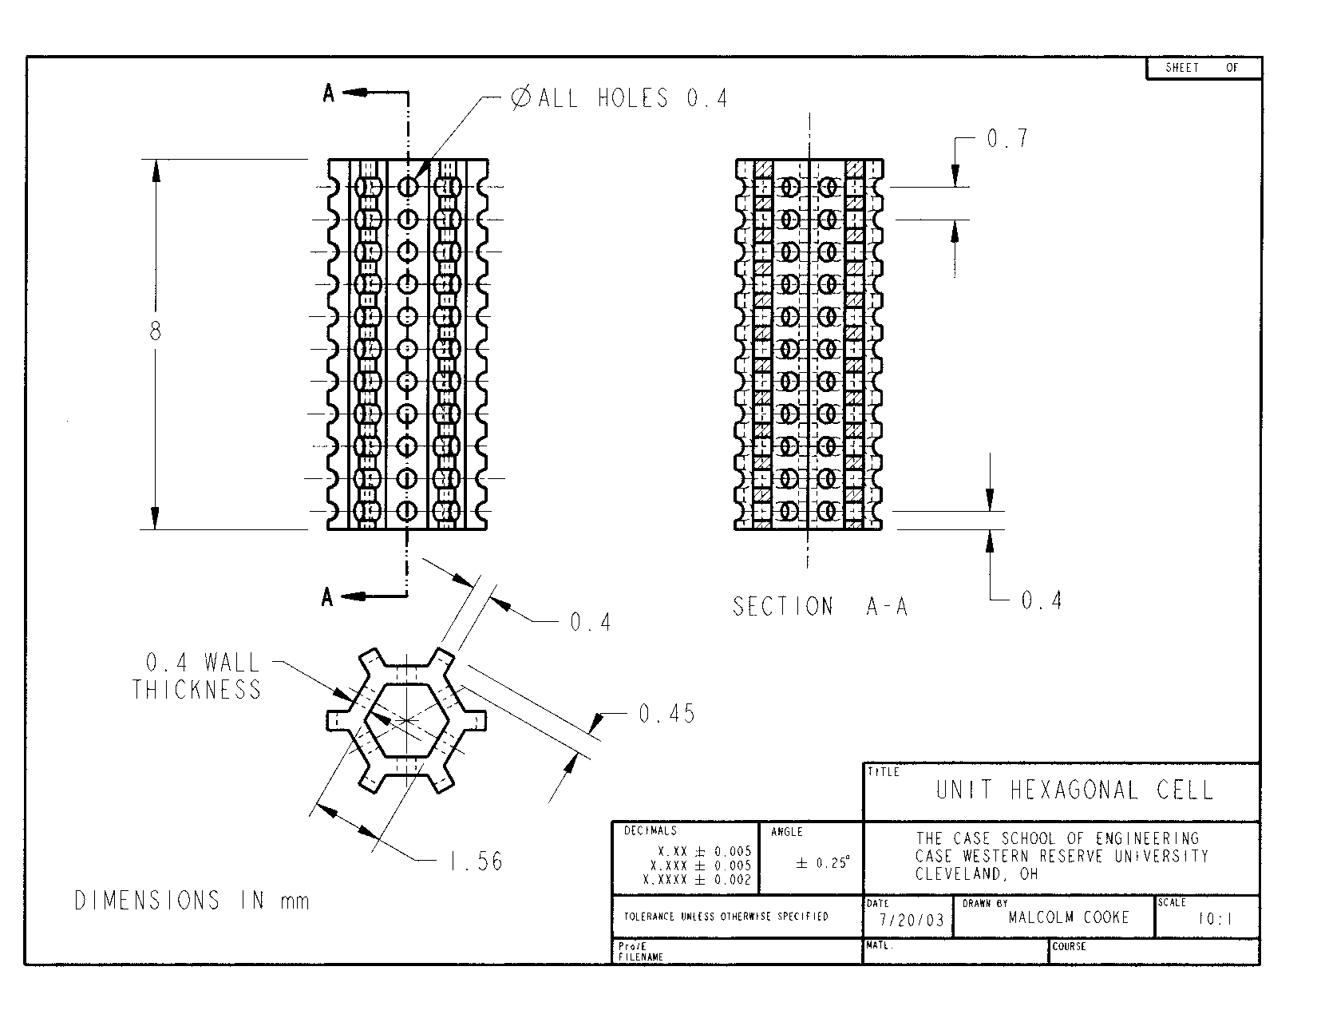
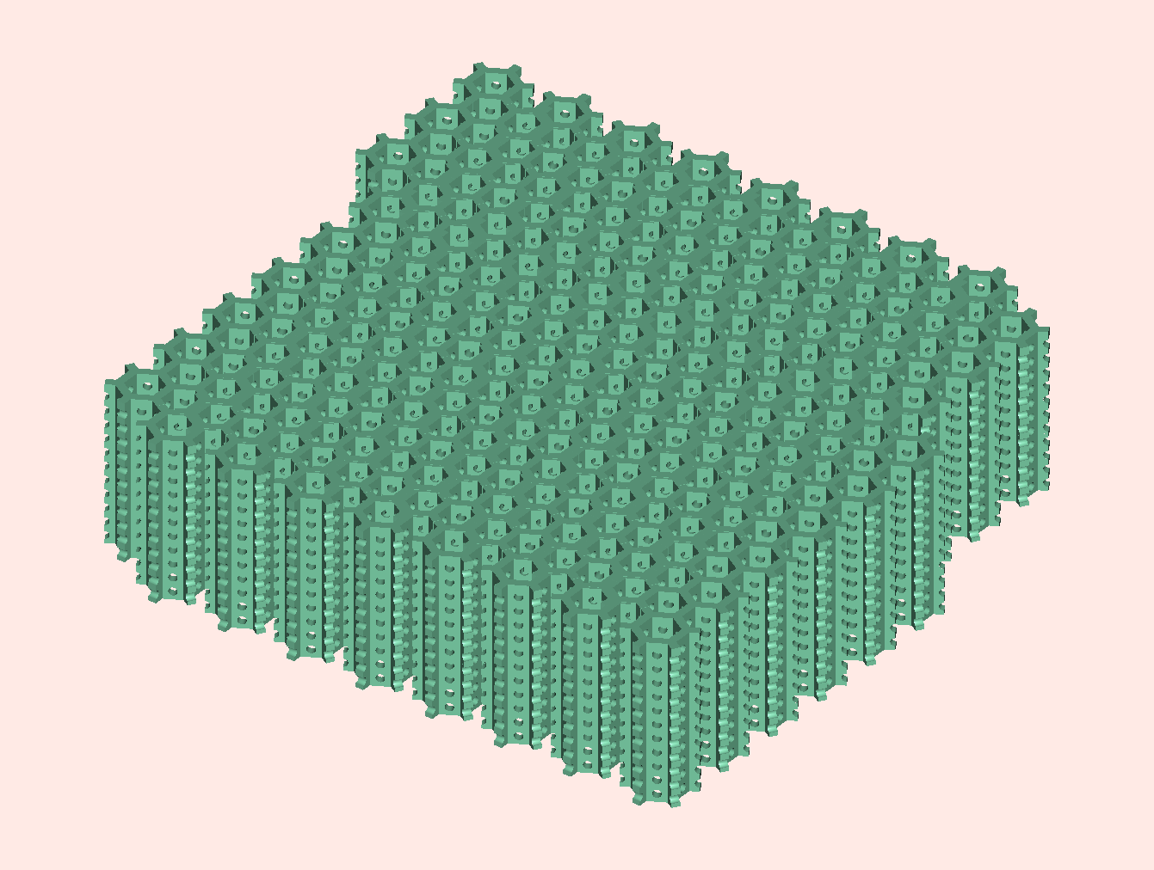
3.5 Control Porous Resorptive Fronts
Design porous margins of cranial implants to promote bony ingrowth.

Slide 25
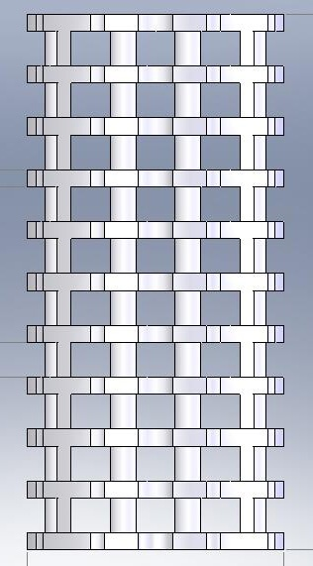
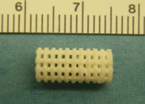
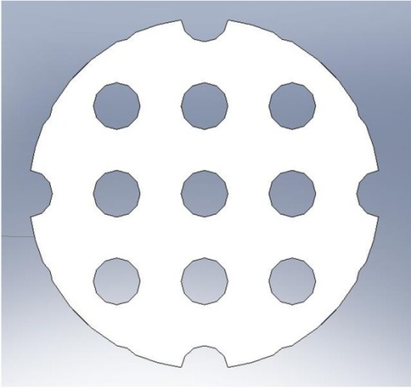
3.6 Test Scaffold: “Plate and Post” Geometry
Implant Design
Highest accuracy in Z with SLA was 400 microns.
800 μm diameter vertical channels.
400 μm thick plates with 800 μm gaps.
Large vertical channels facilitate scaffold loading and vasculature.
Inter-plate spaces open toward defect margin to facilitate tissue in-growth in cranial model.
Use cylinder in athymic nude rat model with allogenic cells.
cDLP- rendered scaffold
CAD file
Notes:
Osseointegration of PPF Cranial Implants
04/11/03
David Dean, Ph.D.
25

Slide 26
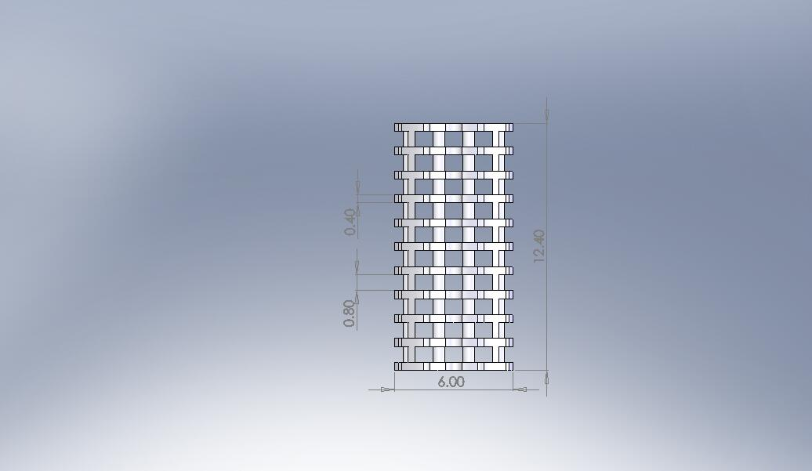
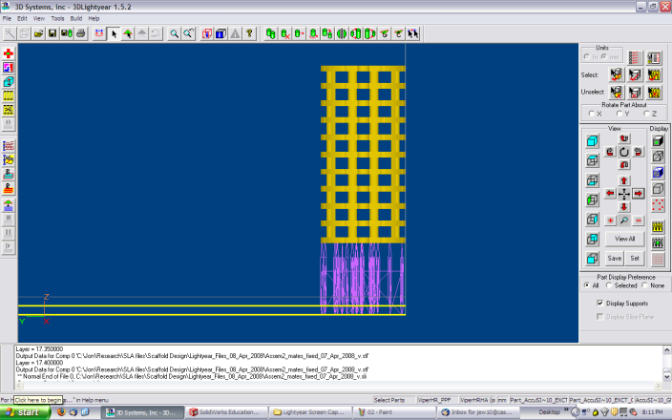
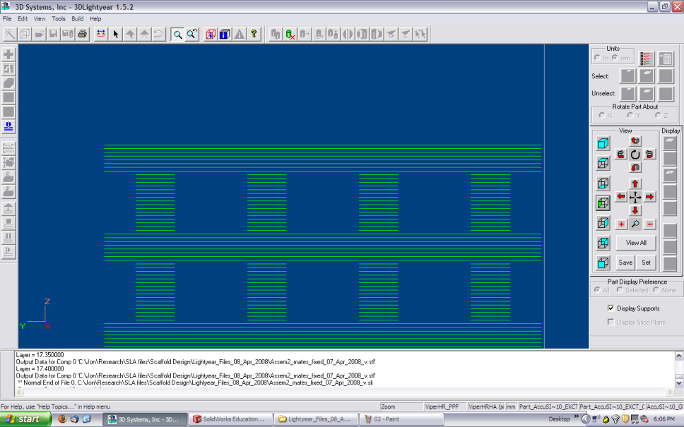
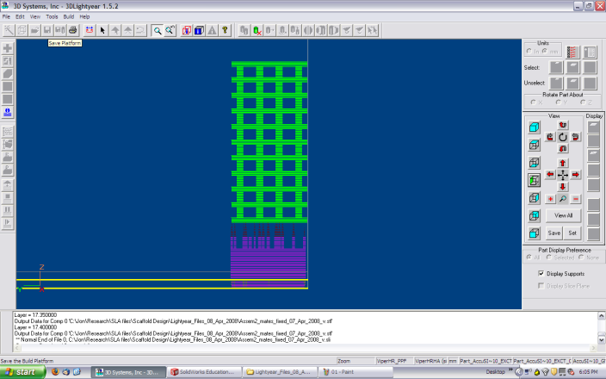
3.7 Preparing the Design for Additive Manufacturing
Create design in CAD software and convert to STL file.
Create Support Structures.
Slice the STL file into layers to create a Build File.
Notes:
26

Slide 27
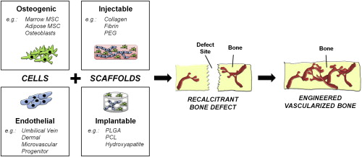
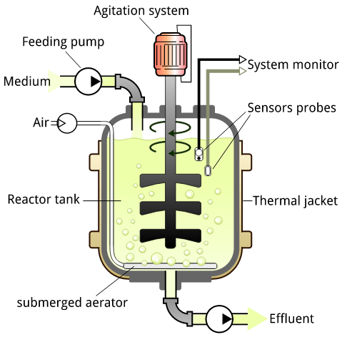
3.8 Applications: Tissue Engineering
Scaffold
Stem Cells
Growth Factors
Bioreactor
Example:
Cranial Flap Regeneration:
Design Scaffold
AM of design in resorbable
material
Rao RR, Stegemann JP. Cell-based approaches to the engineering of vascularized bone tissue. Cytotherapy 0:1-14, 2013, p. 5
Bioreactor
http://upload.wikimedia.org/wikipedia/commons/e/ee/Bioreactor_principle.svg

Slide 28
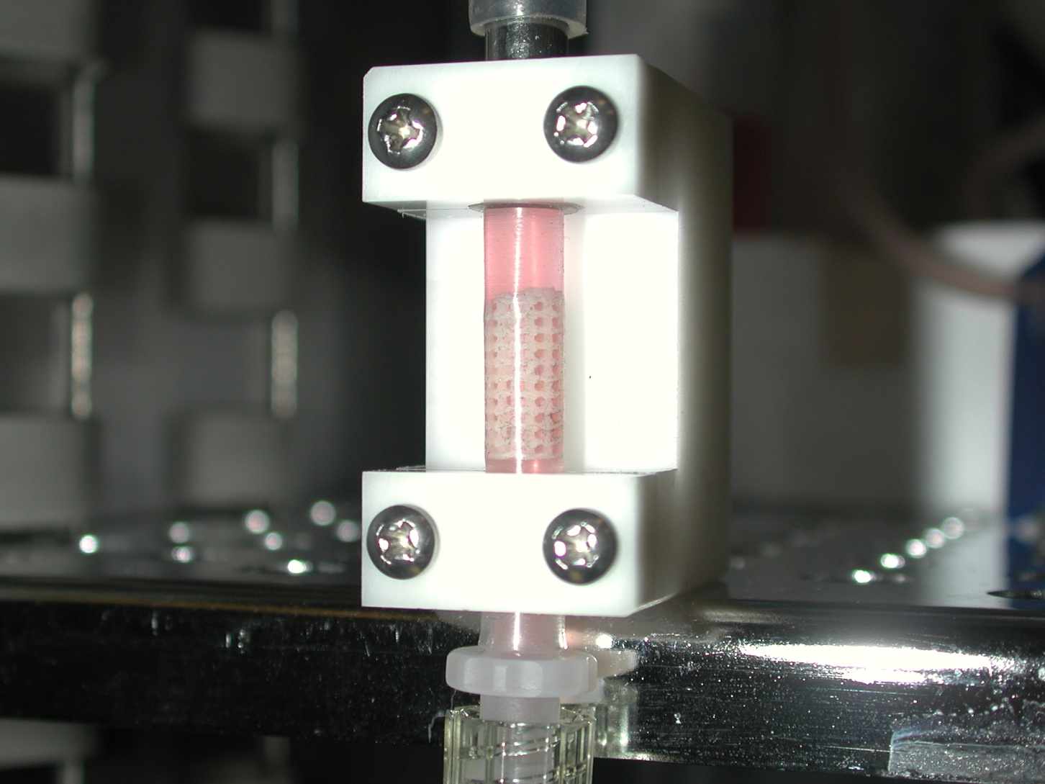
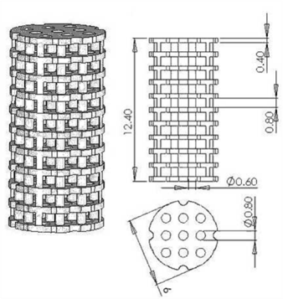
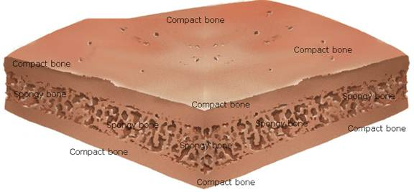
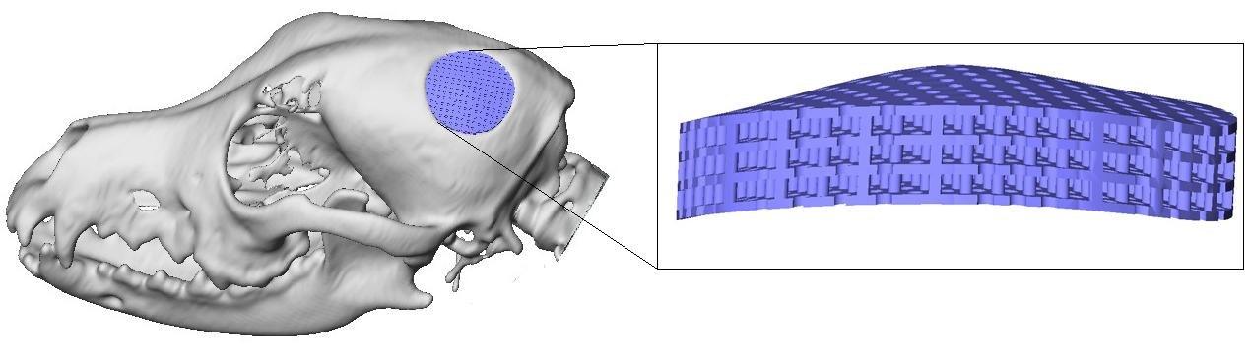
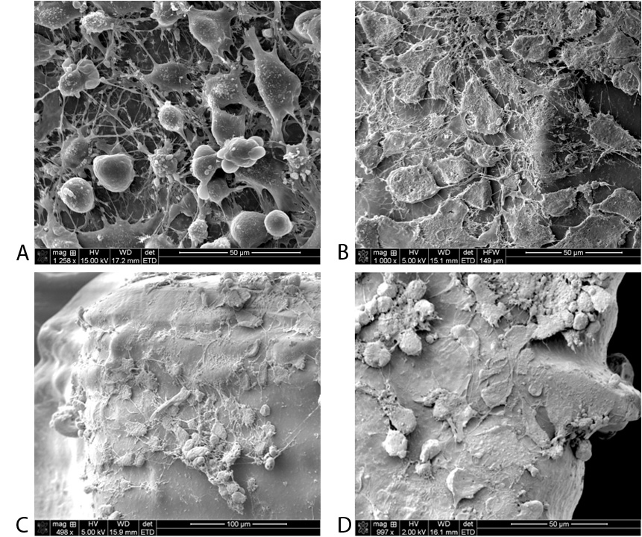
Bioreactor
MSCs Seeded on Resorbable Polymer Implant.
Teleanatomy.com

Slide 29
Overview
I Clinical Problem: Large Cranial Defects
II Cranial Implant Computer Aided Design (CAD)
III Light-based polymerization of PPF Scaffolds
IV Initiators, Dyes, Biologics, Crystals, and Solvents
V Discussion
October 4, 2013
Notes:
Talk overview

Slide 30
4.1 Initiator, Dyes/Biologics, Crystals, and Solvents
Polymerization Initiation: Photo-initiator (0.5-2.0%): bis(2,4,6-trimethylbenzoyl) phenylphosphine oxide (BAPO) Irgacure 819 or Irgacure 784.
Depth of polymerization: Used pharmaceuticals, TiO₂, and benzophenone (HMB).
Surface Roughness: 3D-printed PPF is hydrophobic and smooth. Add HA or b-TCP

Slide 31
4.2 Solvent for High Viscosity
PPF is extremely viscous, may not flow in 3D printing
Higher molecular weight PPF provides good bone ingrowth, but does not always fully resorb.
We have studied low molecular weight PPF.
One could also make features thinner to insure resorption.
Additive Manufacturing allows control of both external shape and internal pore geometry.
DEF is incorporated in the scaffold, reducing rigidity.
Strength reduces dramatically between 50-75% DEF
Notes:
Osseointegration of PPF Cranial Implants
04/11/03
David Dean, Ph.D.
31

Slide 32
4.3 cDLP Improves Resolution and Green Strength
Perfactory® UV device with 60 mm lens
native 71 μm in-plane (x,y) resolution
35.5 μm in-plane (x,y) resolution with anti-aliasing
Yellow azo chromium dye was added to PPF
Photo-polymerization initiator, Irgacure® 819 (BASF (Ciba, Florham Park, NJ), BAPO, was added to polymer
Diethyl fumarate, the monomer precursor of PPF, was added as a solvent in a 1:1 ratio to PPF
Between plane (z) voxel height 120 μm rendering designed 50 μm layers
200 mW/dm² irradiance
layer exposure time of 300 s.
Design is 50 μm layer thickness
Rendered with 120 μm thick layers

Slide 33
4.4 Dye-Initiator Packages
Dye competes with initiator.
Dye creates maximum depth of penetration regardless of energy input used.
Three types of dyes:
UV absorber
UV blocker
UV scatterer
Like monomer (DEF), dye is incorporated into scaffold, therefore, dye must be biocompatible.
Sufficient solubility to insure properties do not change during build cycle.

Slide 34
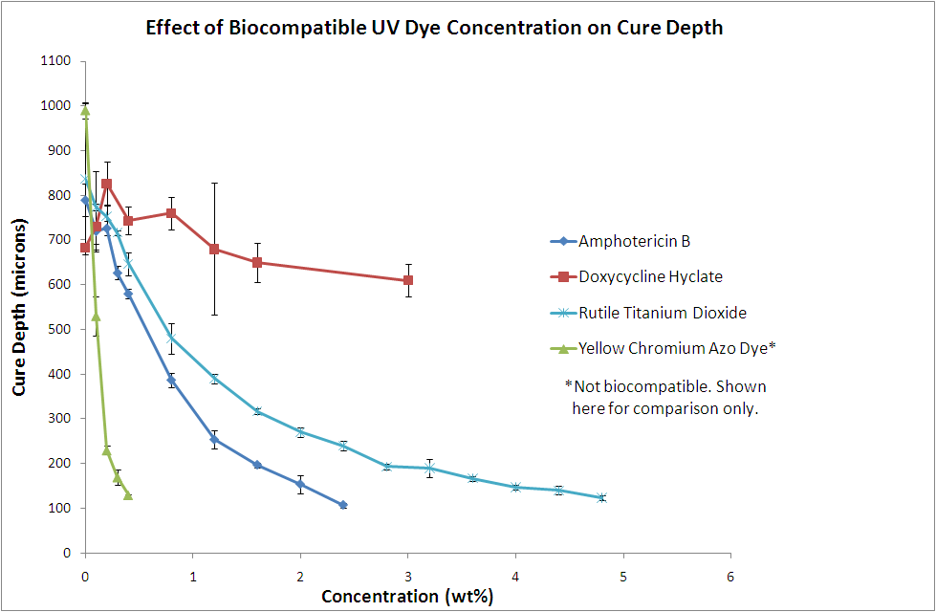
4.5 Biocompatible Dyes
Azo Chromium dye
120μ @ <1%
Potential secondary properties of dyes
Extracellular Matrix Component
Surface Roughness (particulate)
Buffer pH
Color
Antibiotic
Antibiotics
Doxycycline Hyclate
< 600μ
Amphotericin B
120μ but < 2%
Titanium Dioxide (rutile)
120μ but lateral overcure
The relationship between cure depth (µm) and concentration (wt%) for three biocompatible dyes (amphotericin B, doxycycline hyclate, and rutile titanium dioxide).

Slide 35
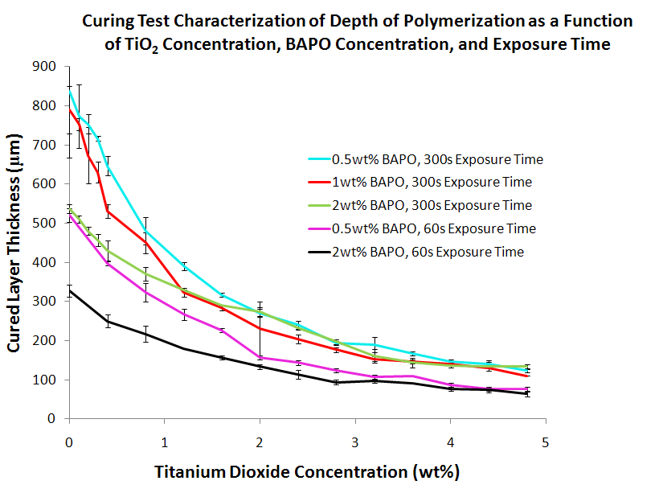
4.6 TiO₂ (rutile)
USP and FCC sources available
Our source: Sachtleben (White Plains, NY) 320 nm crystals
Little affect above 2% BAPO concentration
Depth of polymerization (µm) was characterized as a function of titanium dioxide concentration (wt%) for five different combinations of BAPO concentration (wt%) and exposure time (s = seconds).

Slide 36
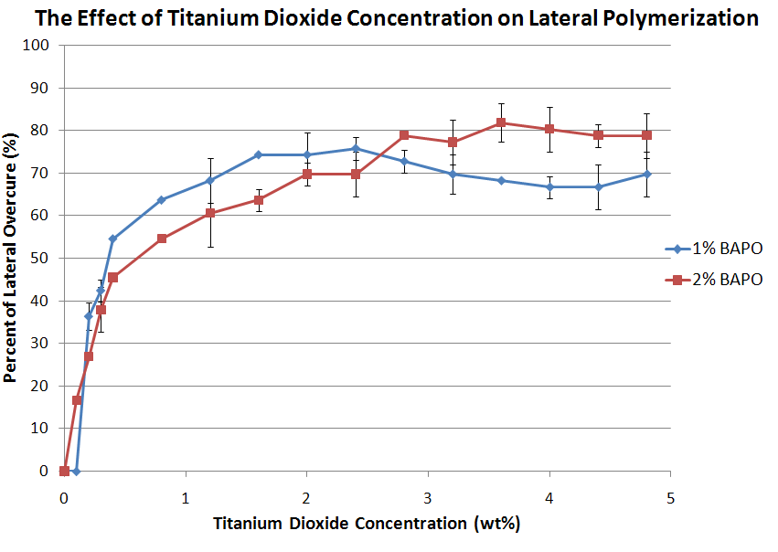
4.7 TiO2 Lateral Overcure
Lateral overcure
Minimized below best concentration for BAPO (2%)
May have little affect on build accuracy
Increasing titanium dioxide concentration led to an increased amount of lateral overcuring.
Lateral overcure measurement.

Slide 37
Other dyes? I819 + I784 + HMB?
Accuracy?
Pre- to post-cure strength?
Table?

Slide 38
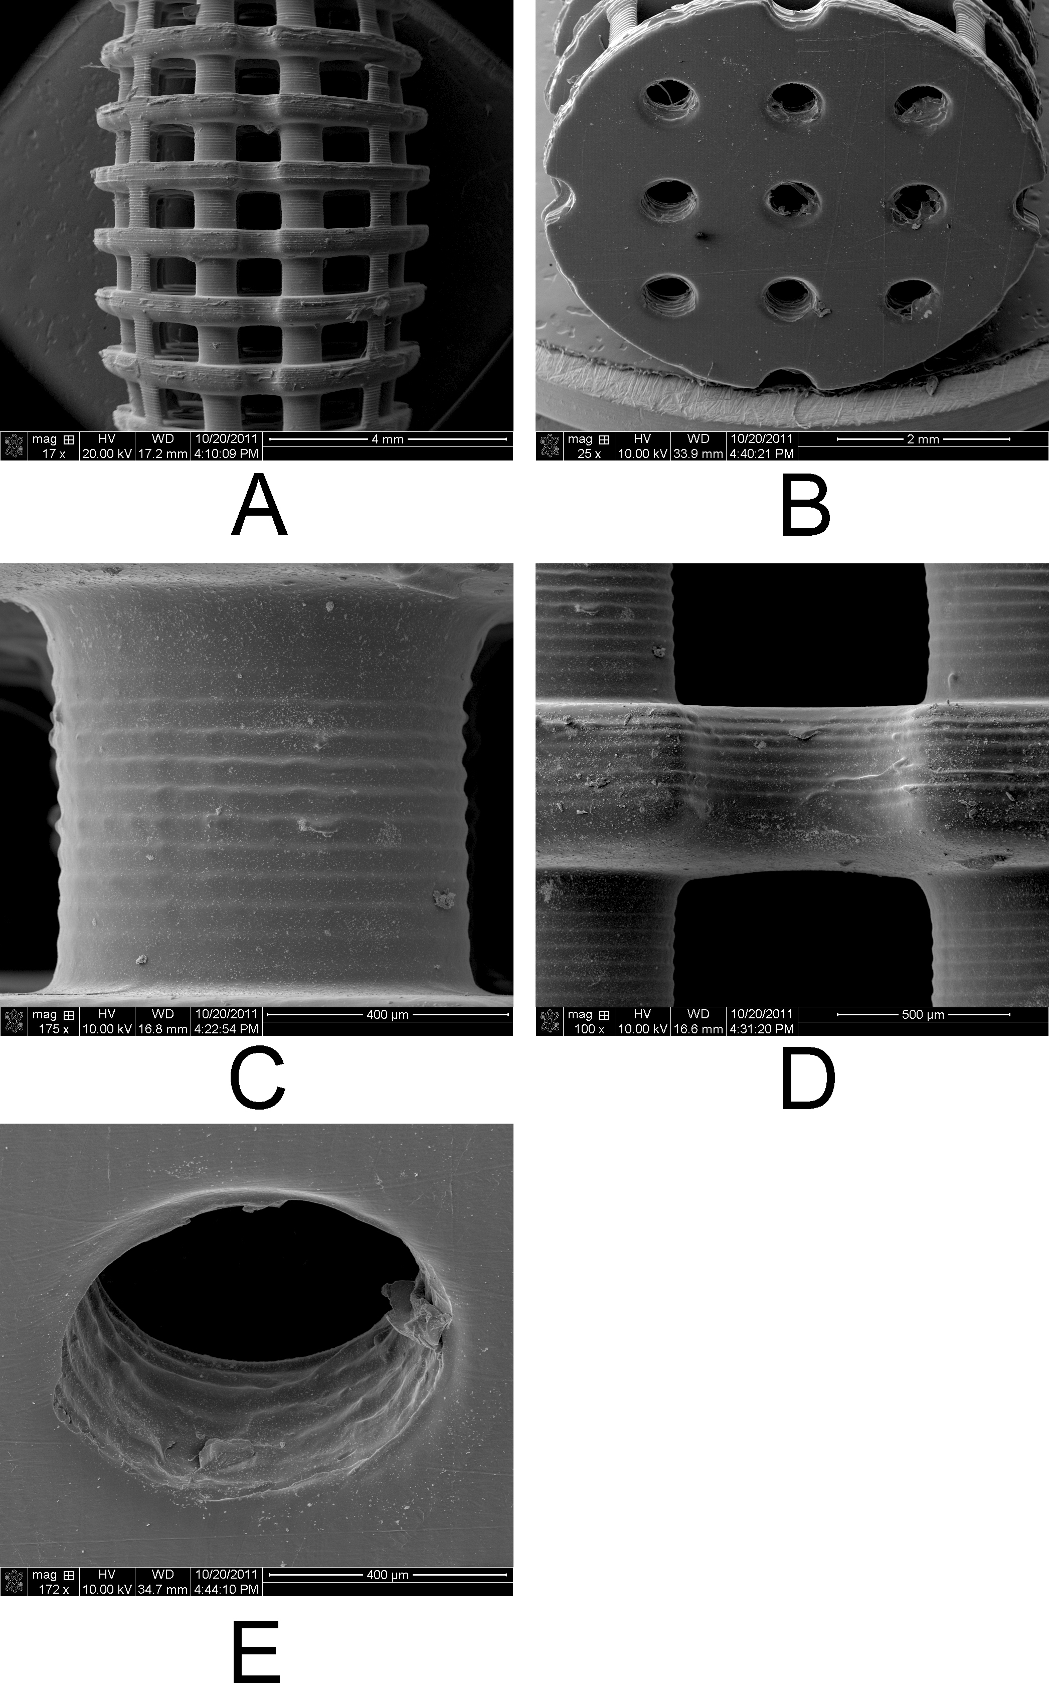
TiO₂ Allows High Accuracy
SEM of plate and post scaffolds
Feature thickness accuracy within 6.2 μ
Curved feature inaccuracy 5.8-35.8%

Slide 39
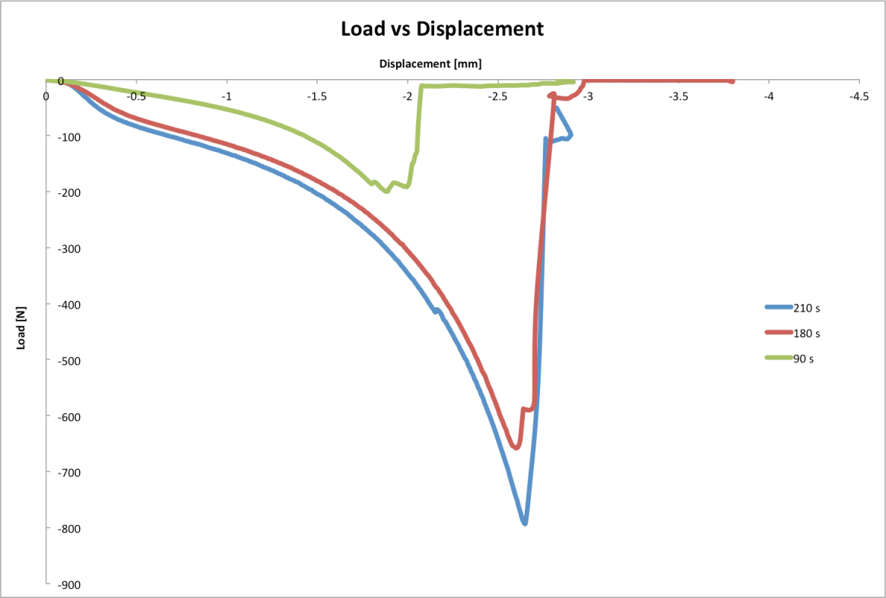
Tuning Resin Strength
Mechanical Testing
______________________________________________
Exposure Time Layer Thickness Average Modulus (N)
90 sec 120 mm 33 MPa (1)
180 sec 150 mm 166 MPa (3)
210 sec 180 mm 195 MPa(5)
Must be able to clean pores prior to post-processing
Must be able to handle surgically following post-processing

Slide 40
Surface Roughness
100 nm, 1 m, 10 m, 100 m
Quantify features in RMS roughness and height map
Affect on MSC attachment and proliferation
Cells perceive mechanically
Cells perceive chemically
Which are determinant at different scale?

Slide 41
Overview
I Clinical Problem: Large Cranial Defects
II Cranial Implant Computer Aided Design (CAD)
III Light-based polymerization of PPF Scaffolds
IV Initiators, Dyes, Biologics, Crystals, and Solvents
V Discussion
October 4, 2013
Notes:
Talk overview

Slide 42
5.1 Discussion
Secondary uses for dyes or other resin solutes:
Extracellular Matrix Component
Surface Roughness (particulate)
Buffer pH
Color
Antibiotic
biocompatibile dye that is FCC or USP grade.
Exposure time (energy) affects layer thickness and strength.
Delamination is a problem with insufficient curing.
Too much time leads to basement plate adhesion.

Slide 43
5.2 Future Work
Light sources (mercury lamp vs LED)
Peeling mechanism?
Basement plate adhesion?

Slide 44
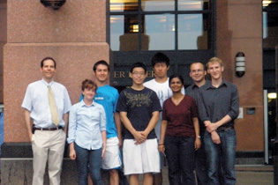
Thank you for your attention. Comments or Questions?
Acknowledgements:
Research Foundation of the Department of Neurological Surgery, CASE/UHC
National Institutes of Health grant R01-DE013740
Clinical Tissue Engineering Center, Cleveland, OH
Imaging Laboratory
Department of Neurological Surgery
L-R: David Dean, Kayla Gray, Eric Mott, Ki-tae Park, Kevin Wang, Vaijayantee Belle, Jonathan Wallace, Paul Thompson.
David Dean, Ph.D.
Associate Professor
Department of Plastic Surgery
The Ohio State University
460 West 12th Avenue
Columbus, OH 43210 USA
David.Dean@Case.Edu
Project Collaborators:
PPF Synthesis:
• Martha Wang
Kyobum Kim
John Fisher
Scaffold Rendering and Imaging:
• Jonathan Wallace
Sage Advice:
• Arnold Caplan
• Al Siblani
• Tony Mikos
• Warren Selman
October 4, 2013

